Slide 1

Introduction to Packages
Session 18

Slide 2
Review
Data may get corrupted when two or more threads access the same variable or object at the same time.
The method isAlive() returns true if the thread upon which it is called is still running.
The method join() will wait until the thread on which it is called terminates.
Synchronization is a process that ensures that the resource will be used by only one thread at a time.
Synchronization does not provide any benefit for single threaded programs. In addition, their performance is three to four times slower than their non-synchronized counterparts.
The method wait() tells the calling thread to give up the monitor and enter the sleep state till some other thread enters the same monitor and calls the method notify().

Slide 3
Review Contd…
The method notify() wakes up or notifies the first thread that called wait() on the same object.
The method notifyAll() wakes up or notifies all the threads that called wait() on the same object.
A deadlock occurs when two threads have a circular dependency on a pair of synchronized objects.
Garbage collection in Java is a process whereby the memory allocated to objects, which are no longer in use, may be reclaimed or freed.
The garbage collector runs as a low priority thread and we can never predict when it will collect the objects.

Slide 4
Objectives
Discuss the java.lang package
Identify the various Wrapper classes
Explain the String and StringBuffer classes
Discuss the concept of immutability
Identify the methods of the following classes and interfaces
  Math
  System
  Object
  Class
  ThreadGroup
  Runtime

Slide 5
Code libraries
A library comprises a group of related files.
  For example: a math library will contain functions or subroutines that are used in mathematical calculations.
The basic idea behind using a code library is to sort out files or functions based on their functionality.
Using these predefined codes saves a lot of coding time.
In C libraries are known as header files, in C++ as class libraries and in Java as packages.

Slide 6
Creating packages in Java
In Java, a package is a combination of classes, interfaces and sub-packages.
  For example: java.awt package has a sub-package called event.
A package in Java can be created by including a package statement as the first statement in a Java program.
Syntax to define a package is:
  package <pkgname>;

Slide 7
Creating packages in Java Contd…
When a Java program is executed, the JVM searches for the classes used within the program on the file system.
Uses one of two elements to find a class:
  The package name
  The directories listed in the CLASSPATH environment variable
If no CLASSPATH is defined, then JVM looks for the default java\lib directory and the current working directory.

Slide 8
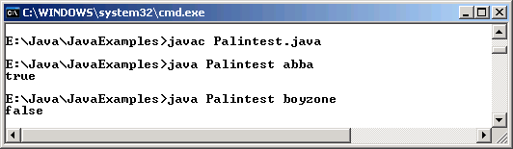
Example
package mypackage;
public class Palindrome
{
public boolean test(String str)
{
char givenstring[];
char reverse[] = new char[str.length()];
boolean flag = true;
int count = 0,ctr = 0;
givenstring = str.toCharArray();
for (count = str.length()-1;count >= 0;count--)
{
reverse[ctr] = givenstring[count];
ctr++;
}
for (count = 0;count < str.length();count++)
{
if (reverse[count] != givenstring[count])
flag = false;
}
return flag;
}
}
import mypackage.*;
class Palintest
{
public static void main(String[] args)
{
Palindrome objPalindrome = new Palindrome();
System.out.println(objPalindrome.test(args[0]));
}
}
Output

Slide 9
Points to be considered
Classes that are intended to be used outside the package within other programs must be declared public.
If two or more packages define a class with the same name and a program happens to import both packages, then the full name of the class with the package name must be used to avoid conflict.

Slide 10
Packages and Access Control
Packages act as a container for classes and other subordinate packages.
Classes are containers of data and code.
Class is the smallest unit of abstraction.
There are four access specifiers: public, private, protected and default or no modifier.

Slide 11
Packages and Access Control
Contd…
A public member of a class can be accessed from anywhere; within the package, outside the package, within a subclass, as well as within a non-subclass.
A member of a class that is declared private can be accessed only within the class but nowhere outside the class.

Slide 12
Packages and Access Control Contd…
A protected member of a class can be accessed from any class in the same package and from a subclass that is outside the package.
If no access specifier is given, the member would be accessible within any class in the same package but not outside the package.

Slide 13
Wrapper Classes
Wrapper classes are a part of java.lang package.
They encapsulate simple primitive types in the form of classes.
It is useful whenever we need object representations of primitive types.
All numeric Wrapper classes extend the abstract superclass Number.

Slide 14
Wrapper Classes Contd…
The six numeric Wrapper classes are Double, Float, Byte, Short, Integer and Long.
Double and Float are wrapper classes for floating point values of type double and float respectively.
Byte, Short, Integer and Long classes are wrappers for byte, short, int and long data types.

Slide 15
Wrapper Classes Contd…
Character is a wrapper class for the primitive char data type.
Boolean is a wrapper class for boolean values.

Slide 16
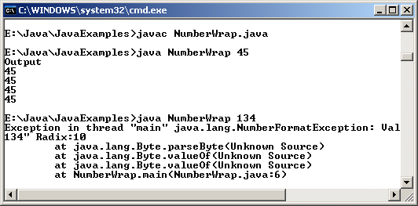
Example
class NumberWrap
{
public static void main(String[] args)
{
String number = args[0];
Byte byNum = Byte.valueOf(number);
Short shNum = Short.valueOf(number);
Integer num = Integer.valueOf(number);
Long lgNum = Long.valueOf(number);
System.out.println("Output");
System.out.println(byNum);
System.out.println(shNum);
System.out.println(num);
System.out.println(lgNum);
}
}
Output

Slide 17
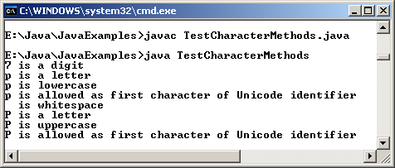
Example Contd…
class TestCharacterMethods
{
public static void main(String[] args)
{
int count;
char values[] = {'*','7','p',' ','P'};
for(count = 0 ; count < values.length ; count++)
{
if(Character.isDigit(values[count]))
System.out.println(values[count]+" is a digit");
if(Character.isLetter(values[count]))
System.out.println(values[count]+" is a letter");
f(Character.isWhitespace(values[count]))
System.out.println(values[count]+" is whitespace");
if(Character.isUpperCase(values[count]))
System.out.println(values[count]+" is uppercase");
if(Character.isLowerCase(values[count]))
System.out.println(values[count]+" is lowercase");
if(Character.isUnicodeIdentifierStart(values[count]))
System.out.println(values[count]+" is allowed as first character of Unicode identifier");
}
}
}
Output

Slide 18
String class
In Java, a string literal is an object of type String class.
Hence manipulation of strings will be done through the use of the methods provided by the String class.
Every time we need an altered version of the String, a new string object is created with the modifications in it.

Slide 19
String Class Contd…
String length(): This method determines the length of a string.
The == operator and equals() method can be used for string comparison.
  The == operator checks if the two operands being used are one and the same object.
  The equals() method checks if the contents of the two operands are the same.

Slide 20
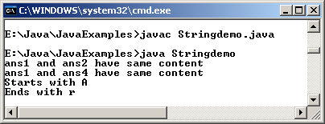
Example
class Stringdemo
{
public static void main(String args[])
{
String ans1, ans2,ans3,ans4;
ans1 = new String("Answer");
ans2 = "Answer";
ans4 = new String("ANSWER");
ans3 = new String("Answer");
if(ans1 == ans2)
System.out.println("ans1 and ans2 are same object");
if(ans1 == ans3)
System.out.println("ans1 and ans3 are same object");
if(ans1.equals(ans2))
System.out.println("ans1 and ans2 have same content");
if(ans1.equalsIgnoreCase(ans4))
System.out.println("ans1 and ans4 have same content");
if(ans1.compareTo("Answers") == 0)
System.out.println("Same content alpabetically");
if(ans1.startsWith("A"))
System.out.println("Starts with A");
if(ans1.endsWith("r"))
System.out.println("Ends with r");
}
}
Output

Slide 21
String Class Contd…
Searching Strings: The String class also provides a variety of methods to perform search operations.
  indexOf() method searches within a string for a given character or String.
The String class provides a number of methods for String extraction or character extraction. In situations where we need to access parts of a string, these methods prove useful.
The method toLowerCase() and toUpperCase() will convert all characters in a string either to lower case or upper case. Both the methods return a String object.

Slide 22
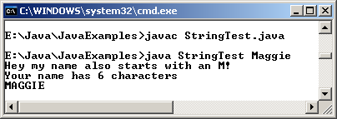
Example
class StringTest
{
public static void main(String[] args)
{
String name = args[0];
if(name.startsWith("M"))
System.out.println("Hey my name also starts with an M! ");
int length = name.length();
System.out.println("Your name has "+length+" characters");
String name_in_caps = name.toUpperCase();
System.out.println(name_in_caps);
}
}
Output

Slide 23
Immutability
Strings in Java once created cannot be changed directly.
This is known as immutability in Strings.

Slide 24
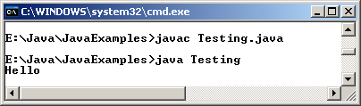
Example
class Testing
{
public static void main(String[] args)
{
String str = "Hello";
str.concat("And Goodbye");
System.out.println(str);
}
}
Output

Slide 25
StringBuffer class
To overcome immutability, Java provides the StringBuffer class, which represents a mutable sequence of characters.
A StringBuffer is used to represent a string that can be modified.
Whenever there is a concatenation operator (+) used with Strings, a StringBuffer object is automatically created.

Slide 26
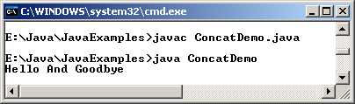
Example
class ConcatDemo
{
public static void main(String[] args)
{
String str = "Hello";
StringBuffer sbObj = new StringBuffer(str);
str = sbObj.append(" And Goodbye").toString();
System.out.println(str);
}
}
Output

Slide 27
Math class
This class defines methods for basic numeric operations as well as geometric functions.
+
%
*
/
-
All the methods of this class are static.
The class is final and hence cannot be subclassed.

Slide 28
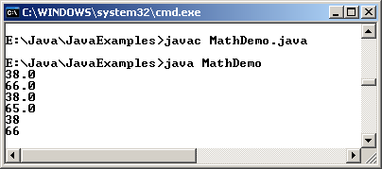
Example
class MathDemo
{
public static void main(String[] args)
{
int num = 38;
float num1 = 65.7f;
System.out.println(Math.ceil(num));
System.out.println(Math.ceil(num1));
System.out.println(Math.floor(num));
System.out.println(Math.floor(num1));
System.out.println(Math.round(num));
System.out.println(Math.round(num1));
}
}
Output

Slide 29
Runtime class
Encapsulates the runtime environment.
Used for memory management and executing additional processes.
Every Java program has a single instance of this class.
We can determine memory allocation details by using totalMemory() and freeMemory() methods.

Slide 30
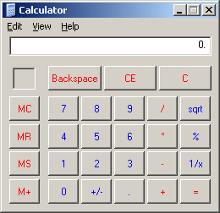
Example
class RuntimeDemo
{
public static void main(String[] args)
{
Runtime Objrun = Runtime.getRuntime();
Process Objprocess = null;
try
{
Objprocess = Objrun.exec("calc.exe");
}
catch(Exception e)
{
System.out.println("Error executing Calculator");
}
}
}
Output

Slide 31
System class
Provides facilities such as the standard input, output and error streams.
Provides means to access properties associated with the Java runtime system.
Fields of this class are in, out and err that represent the standard input, output and error respectively.

Slide 32
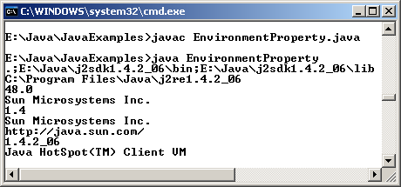
Example
class EnvironmentProperty
{
public static void main(String[] args)
{
System.out.println(System.getProperty("java.class.path"));
System.out.println(System.getProperty("java.home"));
System.out.println(System.getProperty("java.class.version"));
System.out.println(System.getProperty("java.specification.vendor"));
System.out.println(System.getProperty("java.specification.version"));
System.out.println(System.getProperty("java.vendor"));
System.out.println(System.getProperty("java.vendor.url"));
System.out.println(System.getProperty("java.version"));
System.out.println(System.getProperty("java.vm.name"));
}
}
Output

Slide 33
“Class” Class
Instance of this class encapsulates the run time state of an object in a running Java application.
This allows us to retrieve information about the object during runtime.

Slide 34
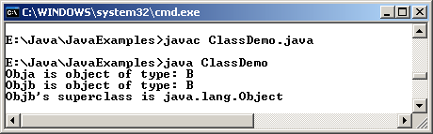
Example
interface A
{
final int id = 1;
final String name = "diana";
}
class B implements A
{
int deptno;
}
class ClassDemo
{
public static void main(String[] args)
{
A Obja = new B();
B Objb = new B( );
Class Objx;
Objx = Obja.getClass();
System.out.println("Obja is object of type: "+ Objx.getName());
Objx = Objb.getClass();
System.out.println("Objb is object of type: "+ Objx.getName());
Objx = Objx.getSuperclass();
System.out.println("Objb's superclass is "+ Objx.getName());
}
}
Output

Slide 35
Object class
Object class is the superclass of all classes.
Even if a user-defined class does not extend from any other class, it extends from the Object class by default.

Slide 36
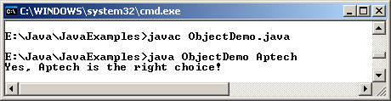
Example
class ObjectDemo
{
public static void main(String args[])
{
if (args[0].equals("Aptech"))
System.out.println("Yes, Aptech is the right choice!");
}
}
Output

Slide 37
Thread, ThreadGroup and Runnable
Multithreading support in Java is provided by means of the Thread and ThreadGroup classes and the Runnable interface.
ThreadGroup is used to create a group of threads.
Whenever it is necessary to manipulate a group of threads as a whole, it is handy to use the ThreadGroup class.

Slide 38
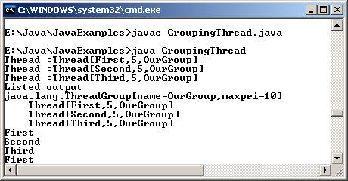
Example
class ChildThread extends Thread
{
ChildThread (String name, ThreadGroup myth)
{
super(myth,name);
System.out.println("Thread :"+this);
start();
}
public void run()
{
try
{
while (true)
{
System.out.println(getName());
Thread.sleep(1000);
}
}
catch(InterruptedException e)
{}
}
}
class GroupingThread
{
public static void main(String[] args)
{
ThreadGroup OurGroup = new ThreadGroup("OurGroup");
ChildThread one = new ChildThread("First",OurGroup);
ChildThread two = new ChildThread("Second",OurGroup);
ChildThread three = new ChildThread("Third",OurGroup);
System.out.println("Listed output");
OurGroup.list();
}
}
Output

Slide 39
Summary
A package is a group of related classes or files.
We can create our own package by including the package command as the first statement in our Java code.
The classes in a package must be saved under a folder that bears the same name as the package.
The java.lang package is imported by default into every Java program.
Wrapper classes encapsulate simple primitive types in the form of classes.
A String literal in Java is an instance of the String class.
The String class provides a variety of methods for searching and extracting portions of Strings.
Though Strings themselves cannot be modified directly we can create new Strings by applying certain methods on them.
The StringBuffer class is used as a building block for building Strings.

Slide 40
Summary Contd…
Strings are immutable which means they are constant and their value cannot be changed.
Math is a final class that defines methods for basic numeric operations as well as geometric functions.
The Runtime class encapsulates the runtime environment and is typically used for memory management and running additional programs.
The System class allows us to access the standard input, output and error streams, provides means to access properties associated with the Java runtime system and various environment properties.
The Object class is the superclass of all classes.
Instances of Class encapsulate the run time state of an object in a running Java application.
Multithreading support in Java is provided by means of the Thread and ThreadGroup classes and the Runnable interface.

